Slide 1
The Blessing
Student Project for Dr. Rick Griffith, Singapore Bible College
BibleStudyDownloads.org

Slide 2
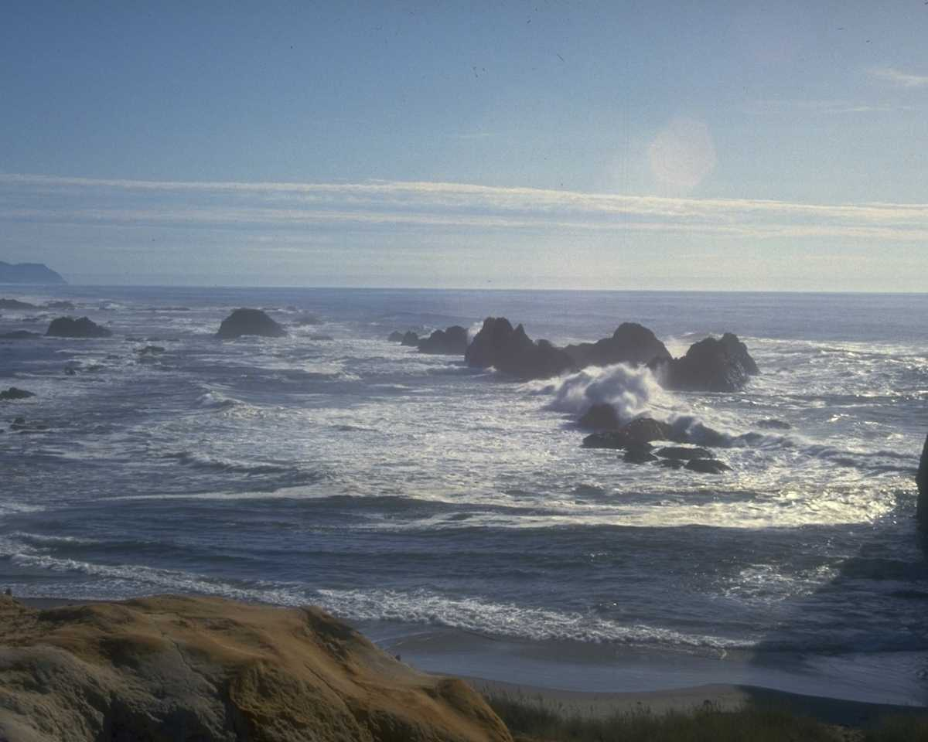
Blessed Be the Tie
Blest be the ties that binds
Our hearts in Christian love
The fellowship of kindred minds
Is like to that of God
(2x)

Slide 3
Quick Quiz

Slide 4
"Younger Blessed":
Quick Quiz
1. Which of the following were firstborn sons in the Bible?
a) Cain, Enosh and Simeon
b) Cain, Japheth and Abraham
c) Cain, Shem and Reuben

Slide 5
2. Which was the younger of the following pairs of siblings?
a) Leah or Rachel
b) Aaron or Moses
c) James or John
d) Andrew or Peter
e) Lee Hsien Yang or Lee Hsien Loong

Slide 6
Answers
1c - Cain, Shem, Reuben
2a. Rachel
2b. Moses
2c. John
2d. Andrew
2e. Lee Hsien Yang

Slide 7
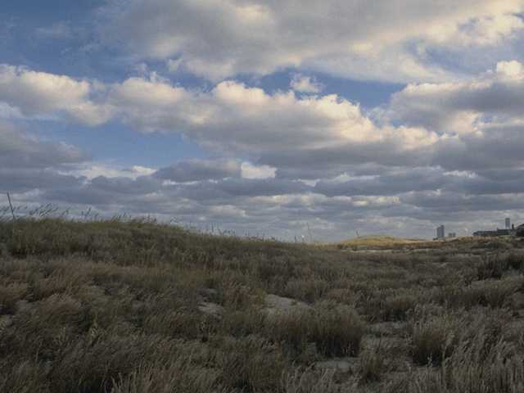
The Younger Blessed

Slide 8
What's the Big Deal?
If firstborn sons were so important in Old Testament times, then why did Abel, Isaac, Jacob, Judah & Joseph enjoy privileged blessings over their firstborn brothers?
Did God have favorites?

Slide 9

What are the
blessings?

Slide 10
Spheres of Blessing
1st sphere: Creation. When God created the earth's animals and Adam & Eve, "He blessed them" (Gen. 1:22, 28)
2nd sphere: Blessing of Noah and his sons (Gen. 9:1)
3rd sphere: Blessing of Abraham and his descendants (Gen. 12:2-3)

Slide 11
Unique Aspects of OT Blessing
God used this to identify His line of blessing through 1 family – the "chosen seed"
God's sovereign choice was seen in who did or did not receive the patriarchal blessing (Jacob not Esau, Ephraim not Manasseh, Judah/ Joseph not Reuben)
Has a prophetic element
Personal/ relational/ emotional relationship between giver and receiver of blessing

Slide 12
Patriarchal Blessing
It was a common practice to bless children
Each child was given a general blessing but the firstborn enjoyed additional privileges plus extra special blessings. Blessing bequeathed to firstborn sons were twice the inheritance of other brothers (2 Kings 2:9)
Once spoken, the blessing was irretrievable (Gen. 27:38)

Slide 13
Blessing In Genesis
The Hebrew word for “blessing” (barek) is found 73 times in Genesis
Blessing in Genesis identified God's favor
To be blessed, the recipient had to be harmony with the donor
God's blessing extended only to those who sought righteousness
Those within the chosen line of seed were divinely empowered to bless or curse others

Slide 14
Concept of Blessing: 2 Aspects
God Blessing Man
Fertility, prosperity and dominion were not essential elements of the blessing. It was the relationship between God and the person blessed that mattered most. God freely bestowed in order to make known to the recipient and to others that God was favorably disposed toward the recipient.

Slide 15
Man Blessing Man
Most human blessings were based upon the relationship between God and the person blessed
The blessing was not a power given by God or another person which a person could keep and distribute as he wishes.
God was the ultimate source of blessing.

Slide 16
Younger Sons Blessed (in red)
Adam
Cain Abel Seth
Enosh Kenan Mahalalel Jared Enoch Methuselah Lamech Noah
Shem Ham Japheth
Arphachad Shelah Eber Peleg Reu Serug Nahor Terah
Abraham Nahor Haran
Ishmael Isaac
Esau Jacob
Reuben Simeon Levi Judah Dan Naphtali Gad Asher Issachar Zebulun Joseph Benjamin

Slide 17
Difference between
OT and NT Blessing
Old Testament
The chosen nation is the locus of God's blessing
A heavy but not exclusive emphasis on physical property
New Testament
Focus changed to individual believers
Little place for material prosperity, as blessing conceived as a spiritual inheritance reserved for believers in heaven

Slide 18
TRACING
THE YOUNGER BLESSED THEME
IN GENESIS

Slide 19
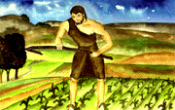
The first secret of the blessings linked to:
"Heart" matters
"First crops" not equal to "first sons"
…Now Abel kept flocks, and Cain worked the soil.

Slide 20
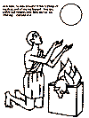
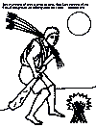
But Abel brought fat portions from some of the firstborn of his flock. The Lord looked with favor on Abel and his offering…

Slide 21
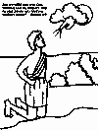
In the course of time Cain brought some of the fruits of the soil as an offering to the Lord.
But on Cain and his offering he did not look with favor.

Slide 22
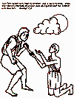

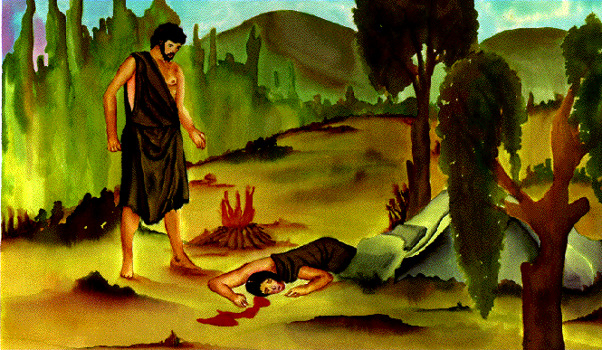

Slide 23
God knew Cain's heart even before the time of offering.
So God rejected the offering of Cain.
Cain kept the sin of jealousy in his heart which was revealed when he killed his brother.
1 John 3:12
"Do not be like Cain, who belonged to the evil one and murdered his brother. And why did he murder him? Because his own actions were evil and his brother's were righteous."

Slide 24
Summary
God favored Abel over Cain.
It was not the “gift” but the “giver”
Abel gave what was costly to him – the “fat pieces,” the choicest parts—the firstborn of his flock.
The focus was on the two men and their heart condition.
God's favor was directed toward the person first, then the offering brought.
Cain's heart and not his offering was the problem – verse 5 – "so Cain was very angry, and his face was downcast." Instead of rectifying his attitude, Cain allowed his heart to harden further towards murder. Cain hid his anger within his heart, away from his brother’s sight.

Slide 25
The second secret of blessings

Slide 26
Abraham also was younger
"Terah became the father of Abram, Nahor and Haran" (Gen. 11:27).
Haran had a son (Lot) even before Abram and Nahor were married, so Haran was the oldest in the family.

Slide 27
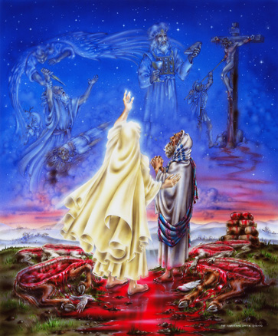
Abrahamic Covenant
I will make you a great nation
and I will bless you;
I will make your name great,
and you will be a blessing.
I will bless those who bless you,
and whoever curses you
I will curse;
and all peoples on earth
will be blessed in you"
(Gen. 12:2-3)

Slide 28
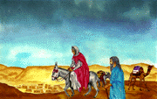
The secret:
RIGHTEOUSNESS
FAITH
OBEDIENCE

Slide 29
Hebrews 11:8-9
“By faith Abraham, when called to go to a place he would later receive as his inheritance, obeyed and went, even though he did not know where he was going.
By faith he made his home in the promised land like a stranger in a foreign country”

Slide 30
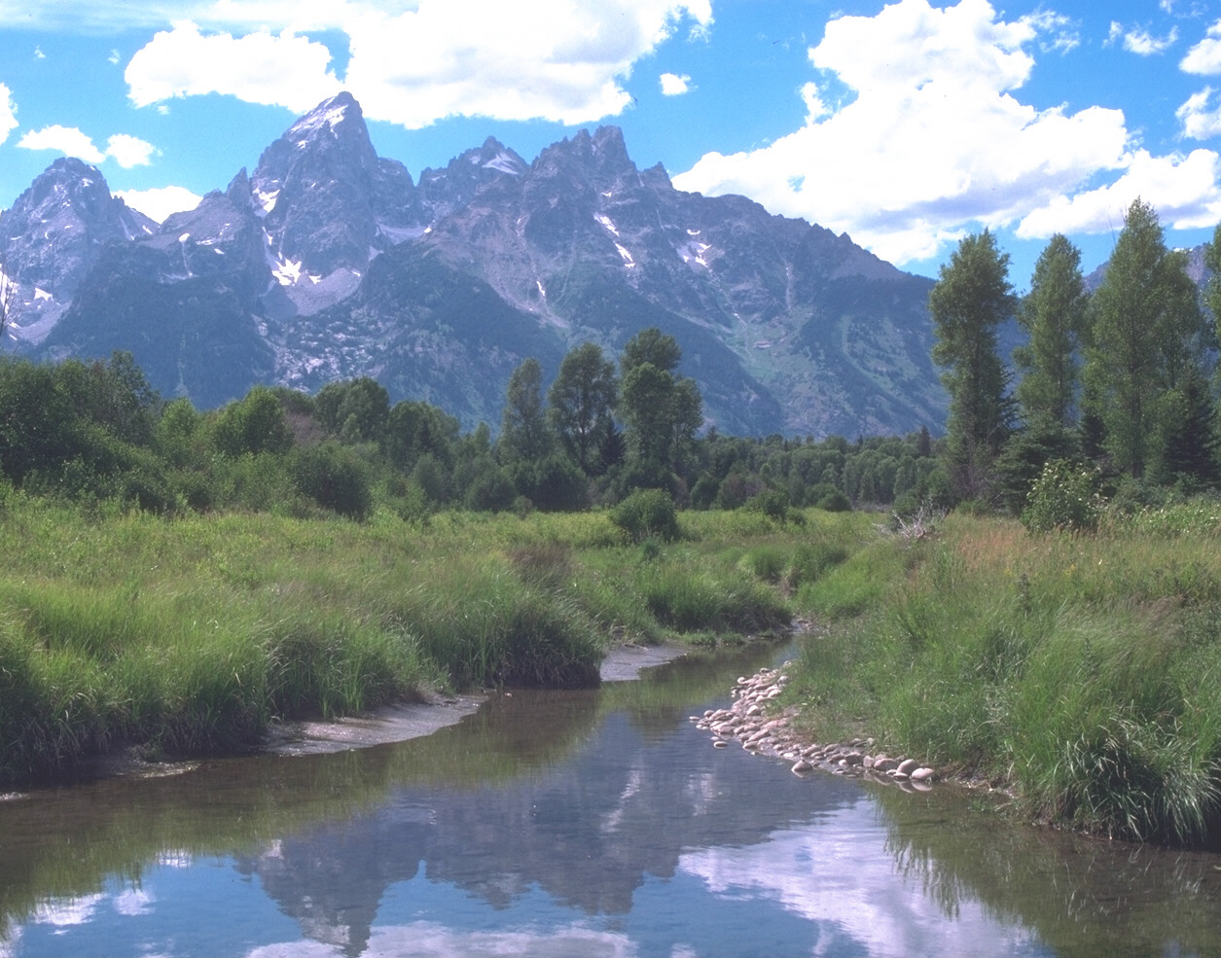
Hebrews 11:13
"All these people were still living by faith when they died. They did not receive the things promised; they only saw them and welcomed them from a distance. And they admitted that they were aliens and strangers on earth."
Verse 16
"…Therefore God is not ashamed to be called their God, for he has prepared a city for them."

Slide 31
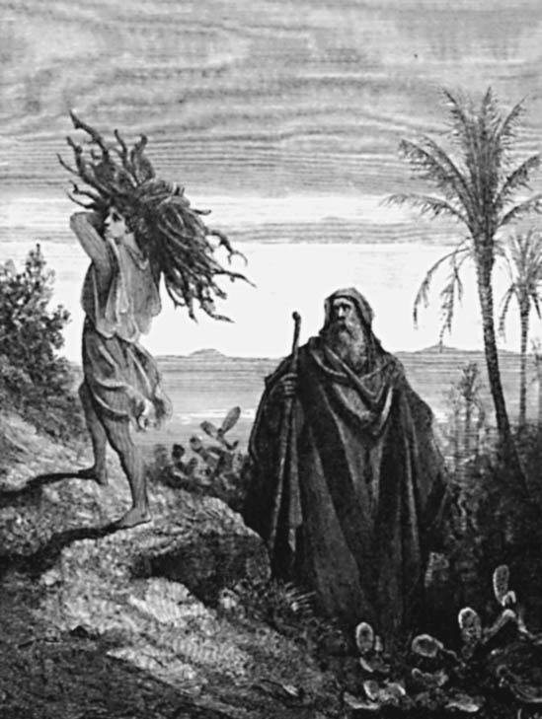
Obedience
Genesis 22:6
"Abraham took the wood for the burnt offering and placed it on his son Isaac, and he himself carried the fire and the knife…"

Slide 32
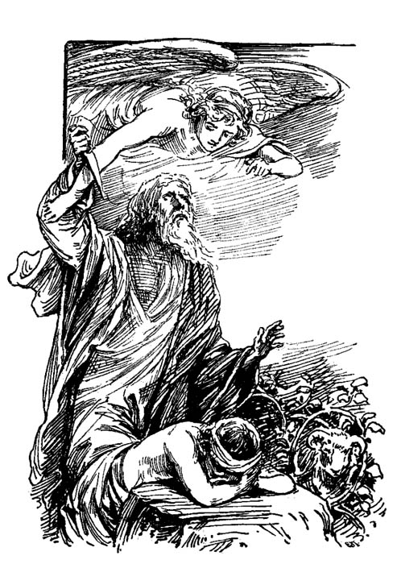
“If you belong to Christ, then you are Abraham's seed, and heirs according to the promise.”
Galatians 3:29 (NIV)

Slide 33
The third secret of blessings

Slide 34
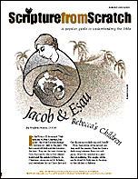
God's sovereign choice
Genesis 25:23
The Lord said to her,
"Two nations are in your womb, and two peoples from within you will be separated; one people will be stronger than the other, and the older will serve the younger."

Slide 35
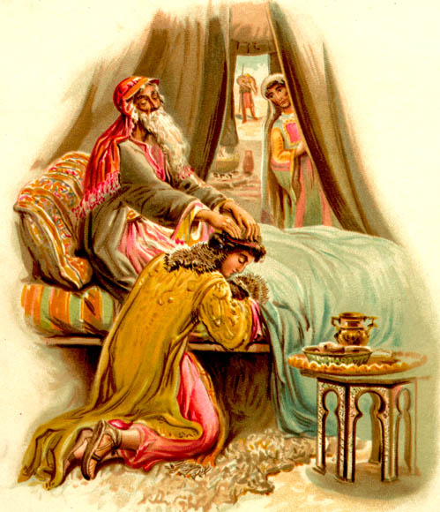
Genesis 27:1-40

Slide 36
Genesis 27:27-29
"… when Isaac caught the smell of his clothes, he blessed him and said, ‘Ah, the smell of my son is like the smell of a field that the Lord has blessed.
May God give you of heaven's dew and of earth's richness – an abundance of grain and new wine.
May nations serve you and peoples bow down to you. Be lord over your brothers, and may the sons of your mother bow down to you. May those who curse you be cursed and those who bless you be blessed.’"

Slide 37

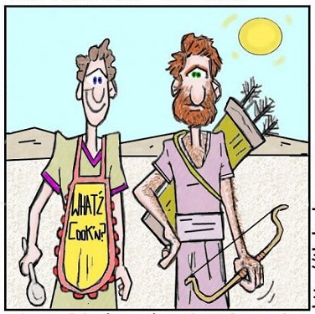
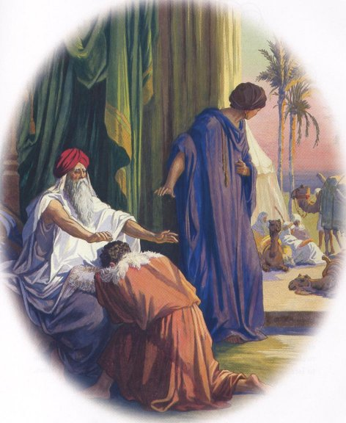
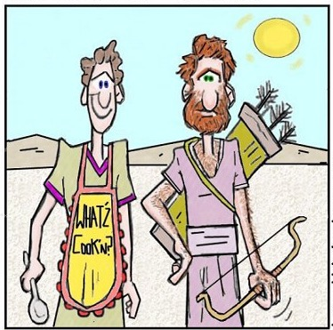
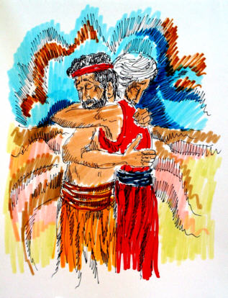
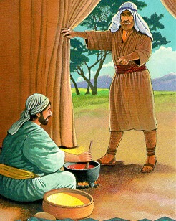
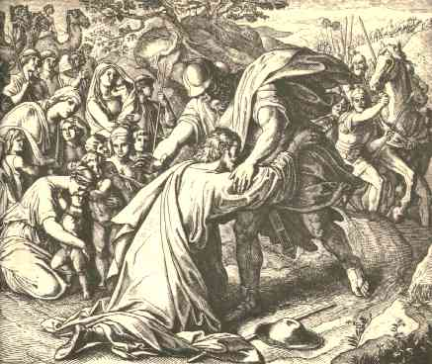
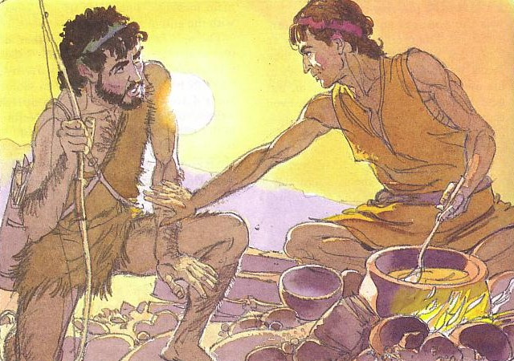
He's So Hairy, Jacob's Brother

Slide 38
Genesis 33
JACOB: FROM DECEIVER TO BELIEVER
God's choice of Jacob finally wins over him without manipulation on Jacob's part.

Slide 39
Malachi 1:2-3
"I have loved you," says the Lord.
"But you asked, 'How have you loved us?'
"Was not Esau Jacob's brother?" the Lord says. "Yet I have loved Jacob,
But Esau I have hated, and I have turned his mountains into a wasteland and left his inheritance to the desert jackals."
Romans 9:13
Just as it is written: "Jacob I loved, but Esau I hated."

Slide 40
Genesis 37:1-11

Slide 41
Genesis 37–40

Slide 42
Genesis 41–50

Slide 43
"You intended to harm me,
but God intended it for good to accomplish what is now being done, the saving of many lives."
Genesis 50:20 (NIV)

Slide 44
Who are the blessed now?
Those who have an obedient heart, seeking God's will first (Matthew 6:33)
Those who are righteous and faithful in God's eyes
Those who keep God's commandments and principles for living (The Beatitudes)
God's sovereignty

Slide 45
Q & A
Discussion Time

Slide 46
Blessed Discussion Groups
Why were only some of the younger sons in the line of blessing? (Why was the older son Shem still chosen?)
Did the blessing pass to Judah (49:8-12) or Joseph (Gen. 48)?
Should we bless only one of our children today? Why or why not?

Slide 47
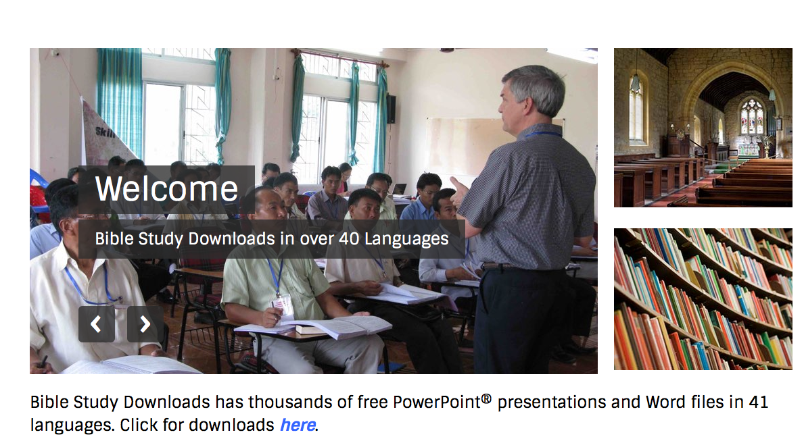
OT Survey link at biblestudydownloads.org
Get this presentation for free!

Slide 48
Black

